Slide 1
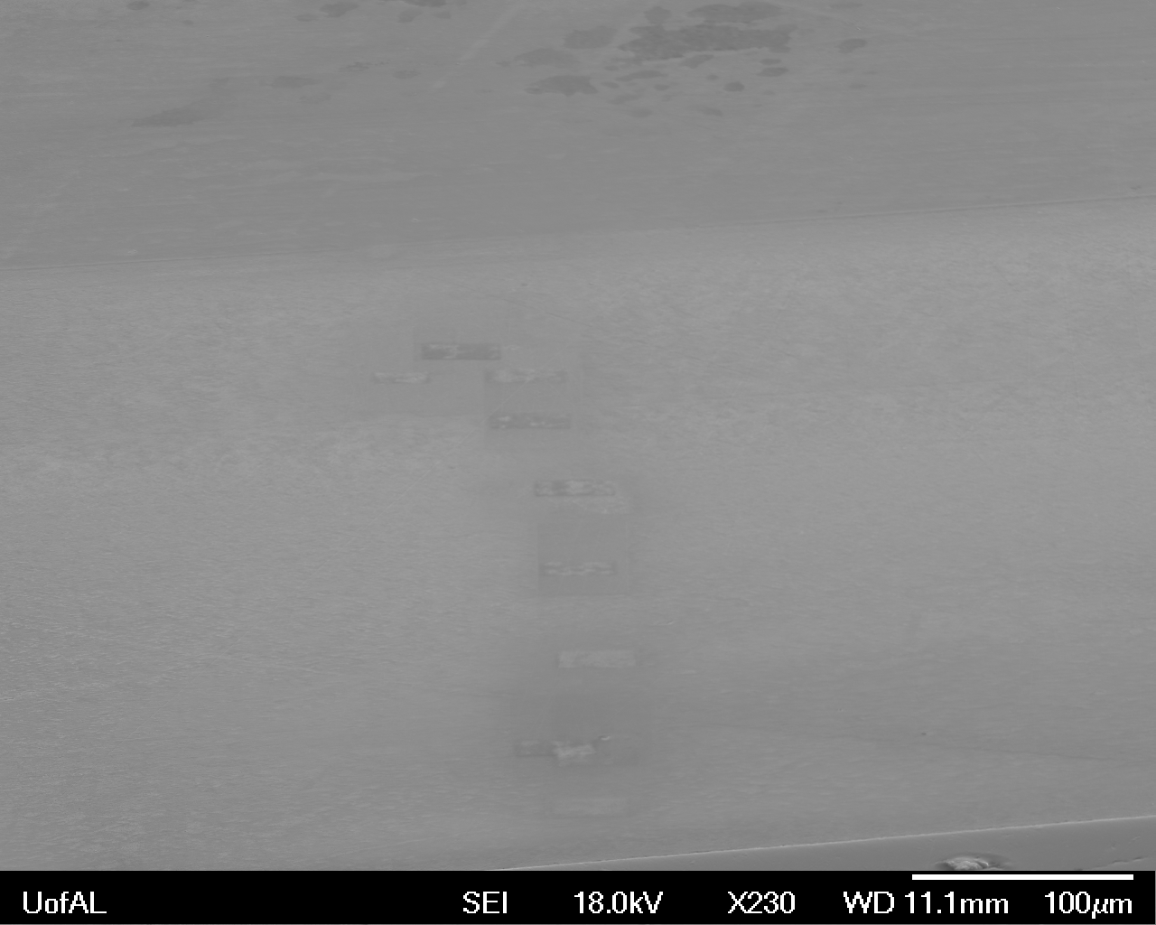
Our hypothesis was that environmental conditions, specifically the temperature in which a bivalve shell was formed, would correlate to structural parameters within the shell, specifically the angle spread footprint of the c-axis of nacre tablets.
To investigate this, a series of ten regions (called: time points) within the nacre of Mytilus edulis(Me) were isolated and scanned using SEM-EBSD. The distance from the first formed nacre layer to the center of these regions was used to assign a environmental temperature to each of the time points.
The regions were selected so that nacre formed under a wide range of temperatures would be examined. We also chose sites that spanned the cross-section of the shell.
Prismatic
Discolored regions where EBSD scans damaged the sample coating
Nacre
TD
RD
Scanning electron micrograph of cross-section of Me shell, post data collection

Slide 2
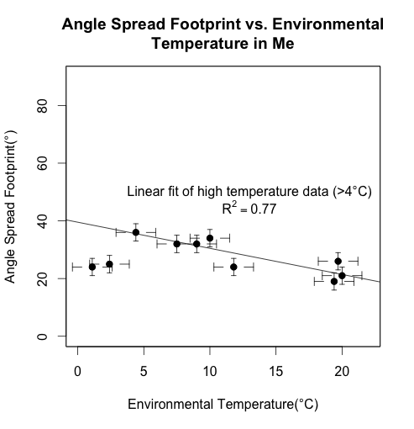
The quantity ‘angle spread footprint’ was obtained using 001 pole figures generated with the EBSD data. The footprint was measured in the plane of the TD and ND(RD X TD = ND, see slide 1).
A plot of the environmental temperature vs. the angle spread footprint revealed a downwards trend which began at temperatures above 4°C. This is the opposite trend from what was seen in the 2012 JACS paper*, where angle spread and temperature were positively correlated.

Slide 3
The trend is only evident when low temperature data points (below 4°C) are discarded. It is possible that metabolic activity of the animal is substantially altered at this point, resulting in a different mechanism of nacre deposition.
There exists no clear relationship between the angle spread footprint and the distance from first formed nacre layer.

Slide 4
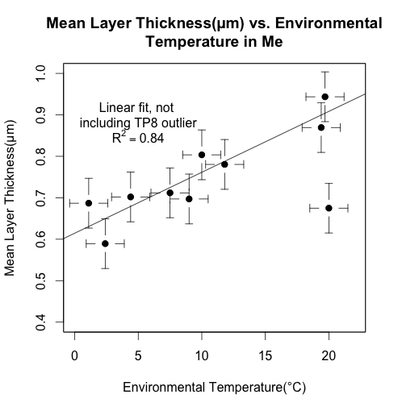
When average layer thickness for each time point is plotted against the environmental temperature associated with that time point, a positive and roughly linear trend seems to emerge, with one significant outlier (time point 8).
Because layer thickness data was so variable, even within an overall larger periodic trend, it is possible that time point 8 is anomalous – a small region of thin layers surrounded on either side by thicker layers.

Slide 5
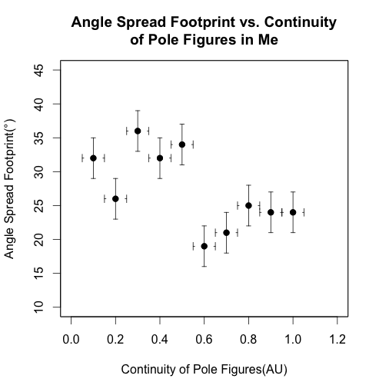
Continuity of 001 pole figures is dispersed evenly over a range from 0 to 1.
Two clusters emerge from the plotted data, where less continuous regions have a wider footprint. This result is counterintuitive – if the continuity was simply a result of a larger number of tablets being sampled, you would think that the more continuous figures would have a wider footprint, simply by virtue of sampling more tablets.

Slide 6
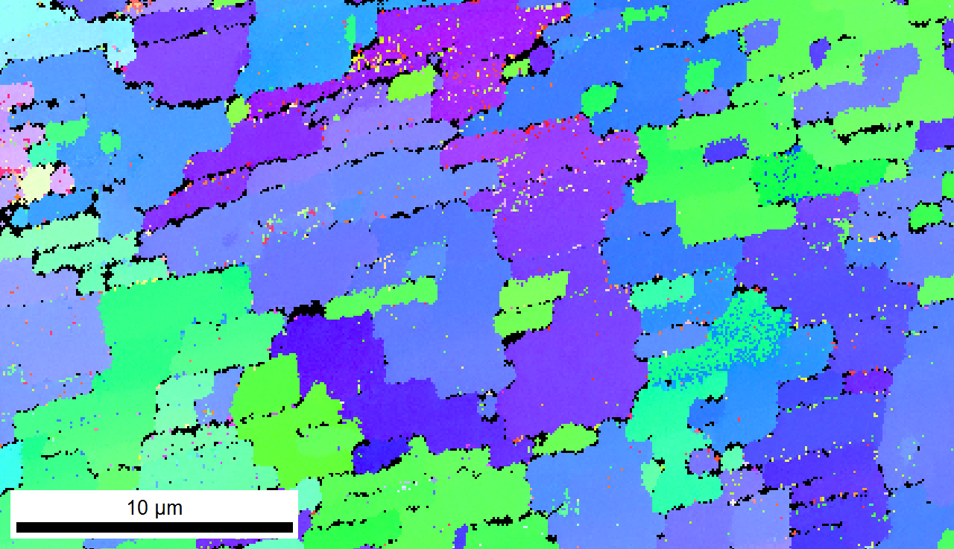
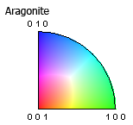
An unexpected and interesting finding was the observation of gradual axis tilting in a series of adjacent nacre tablets in different layers. While this has been observed in gastropod nacre, for which the tablets in different layers are stacked vertically, it has not yet been documented in bivalve nacre, for which tablets in different layers are typically offset laterally.
You can see here a gradual change in orientation where the c-axis moves away from the normal of the image plane as more tablets are deposited.
IPF Map from time point four – color indicates the orientation of each of the three crystal axes (a-, b-, and c-) with respect to the normal of the image plane

Slide 7
*Olson, I., Kozdon, R., Valley, J. & Gilbert, P. Mollusk shell nacre ultrastructure correlates with environmental temperature and pressure. Journal of the American Chemical Society 134, 7351–8 (2012).

